Slide 1
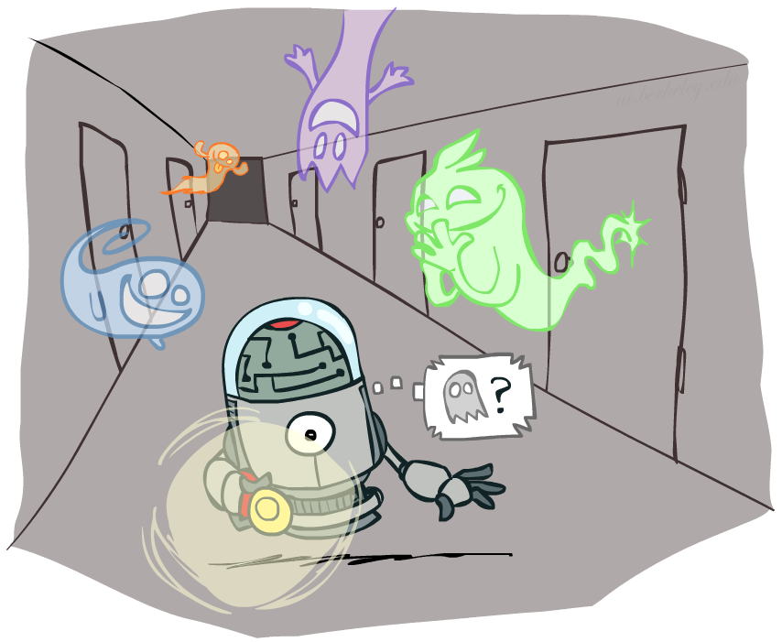
CS 188: Artificial Intelligence
Filtering
Instructor: Anca Dragan --- University of California, Berkeley
[These slides were created by Dan Klein, Pieter Abbeel, and Anca. http://ai.berkeley.edu.]
Notes:
Please retain proper attribution, including the reference to ai.berkeley.edu. Thanks!

Slide 2
Filtering / Monitoring
Filtering, or monitoring, is the task of tracking the distribution B_{t}(X) = P_{t}(X_{t} | e₁, …, e_{t}) (the belief state) over time
We start with B₁(X) in an initial setting, usually uniform
As time passes, or we get observations, we update B(X)
The Kalman filter was invented in the 60’s and first implemented as a method of trajectory estimation for the Apollo program
Notes:
Dan has some demo for this

Slide 3
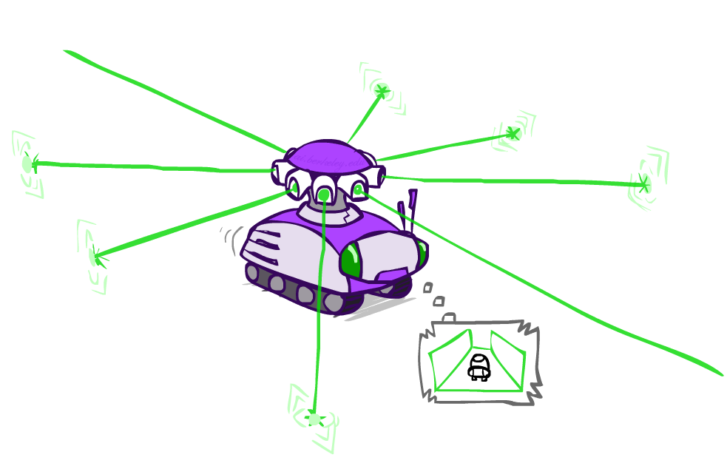
Example: Robot Localization
Example from Michael Pfeiffer
Prob
0
1
t=0
Sensor model: can read in which directions there is a wall, never more than 1 mistake
Motion model: may not execute action with small prob.

Slide 4
Example: Robot Localization
Prob
0
1
t=1
Lighter grey: was possible to get the reading, but less likely b/c required 1 mistake

Slide 5
Example: Robot Localization
Prob
0
1
t=2

Slide 6
Example: Robot Localization
Prob
0
1
t=3

Slide 7
Example: Robot Localization
Prob
0
1
t=4

Slide 8
Example: Robot Localization
Prob
0
1
t=5

Slide 9
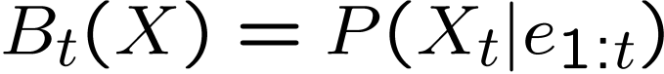
Inference: Find State Given Evidence
We are given evidence at each time and want to know
Idea: start with P(X₁) and derive B_{t} in terms of B_{t-1}
equivalently, derive B_{t+1} in terms of B_{t}

Slide 10
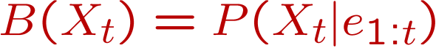
Two Steps: Passage of Time + Observation
X₁
X₂
X₃
X₄
X₅
E₁
E₂
E₃
E₄
E₅

Slide 11
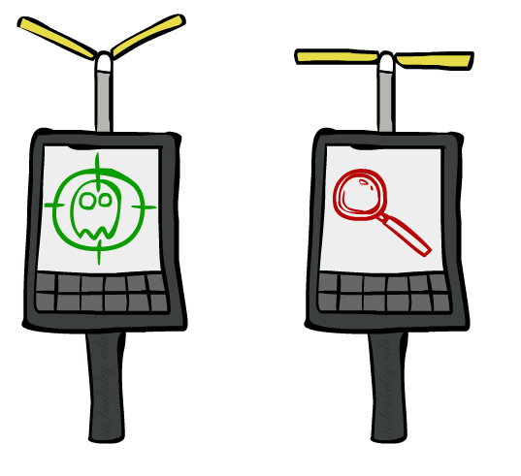

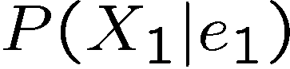
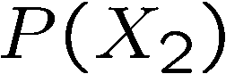
Inference: Base Cases
X₁
X₁
X₂
E₁

Slide 12
Passage of Time
Assume we have current belief P(X | evidence to date)
Then, after one time step passes:
Basic idea: beliefs get “pushed” through the transitions
With the “B” notation, we have to be careful about what time step t the belief is about, and what evidence it includes
X₁
X₂
Or compactly:
Notes:
TODO: intermediate step in derivation!

Slide 13

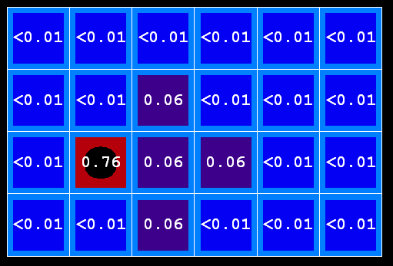
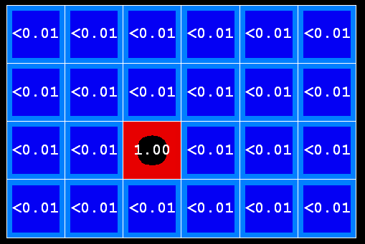
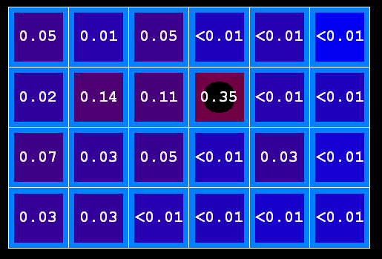
Example: Passage of Time
As time passes, uncertainty “accumulates”
(Transition model: ghosts usually go clockwise)
T = 1
T = 2
T = 5

Slide 14
Observation
X₁
Assume we have current belief P(X | previous evidence):
Then, after evidence comes in:
Or, compactly:
E₁
Basic idea: beliefs “reweighted” by likelihood of evidence
Unlike passage of time, we have to renormalize
Notes:
Basic idea: beliefs “reweighted” by likelihood of evidence
Unlike passage of time, we have to renormalize

Slide 15


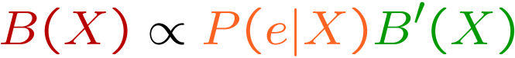
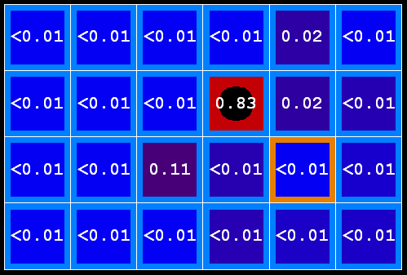
Example: Observation
As we get observations, beliefs get reweighted, uncertainty “decreases”
Before observation
After observation

Slide 16

Example: Weather HMM
B’(+r) = 0.5
B’(-r) = 0.5
B’(+r) = 0.627
B’(-r) = 0.373
B(+r) = 0.5
B(-r) = 0.5
B(+r) = 0.818
B(-r) = 0.182
B(+r) = 0.883
B(-r) = 0.117
Rain₀
Rain₁
Rain₂
R_{t} | R_{t+1} | P(R_{t+1}|R_{t})
+r | +r | 0.7
+r | -r | 0.3
-r | +r | 0.3
-r | -r | 0.7
R_{t} | U_{t} | P(U_{t}|R_{t})
+r | +u | 0.9
+r | -u | 0.1
-r | +u | 0.2
-r | -u | 0.8
Umbrella₁
Umbrella₂
Notes:
demo

Slide 17
Online Belief Updates
Every time step, we start with current P(X | evidence)
We update for time:
We update for evidence:
The forward algorithm does both at once (and doesn’t normalize)
X₁
X₂
X₂
E₂

Slide 18
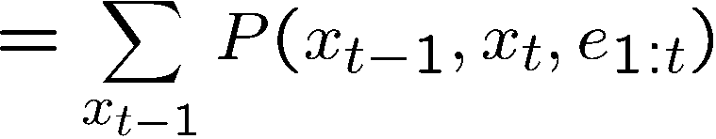
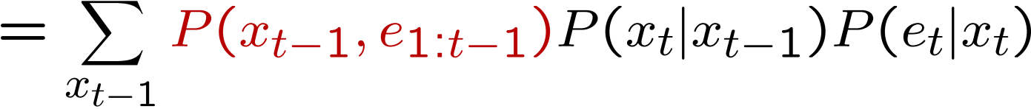
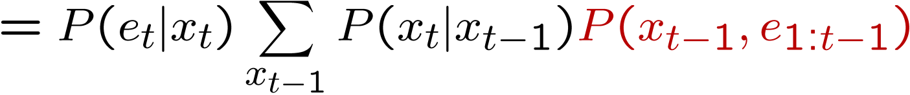
The Forward Algorithm
We are given evidence at each time and want to know
We can derive the following updates
We can normalize as we go if we want to have P(x|e) at each time step, or just once at the end…
t
[Demo: Ghostbusters Exact Filtering (L15D2)]
Notes:
TODO: explain propto and it’s X_t, not X

Slide 19
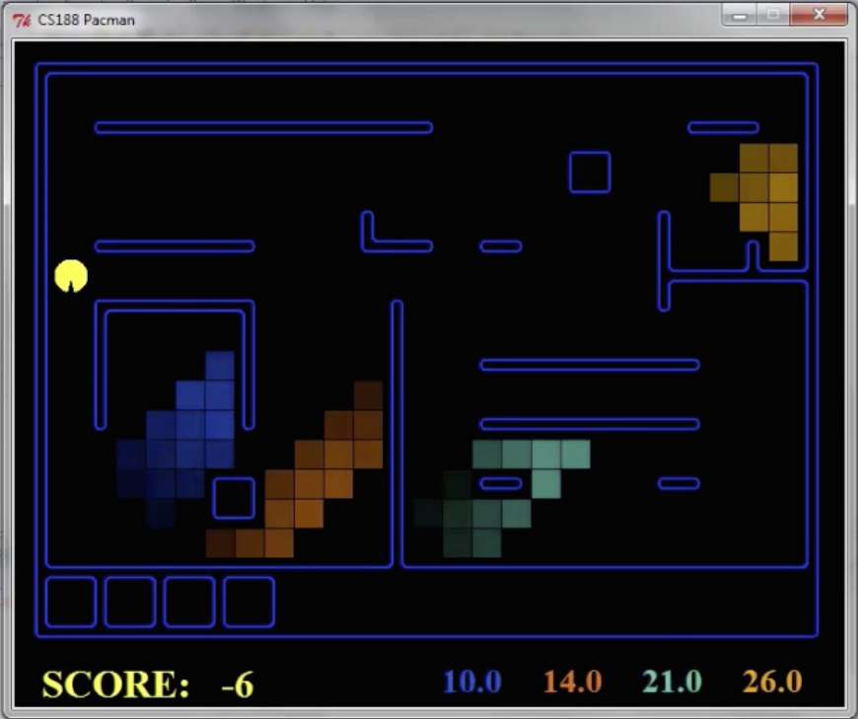
Pacman – Sonar
[Demo: Pacman – Sonar – No Beliefs(L14D1)]

Slide 20

Video of Demo Pacman – Sonar (with beliefs)

Slide 21
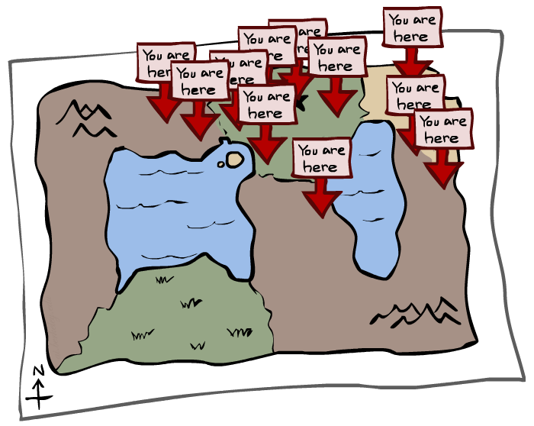
Particle Filtering

Slide 22
Particle Filtering
Filtering: approximate solution
Sometimes |X| is too big to use exact inference
|X| may be too big to even store B(X)
E.g. X is continuous
Solution: approximate inference
Track samples of X, not all values
Samples are called particles
Time per step is linear in the number of samples
But: number needed may be large
In memory: list of particles, not states
This is how robot localization works in practice
Particle is just new name for sample
0.0
0.1
0.0
0.0
0.0
0.2
0.0
0.2
0.5

Slide 23
Representation: Particles
Our representation of P(X) is now a list of N particles (samples)
Generally, N << |X|
P(x) approximated by number of particles with value x
So, many x may have P(x) = 0!
More particles, more accuracy
For now, all particles have a weight of 1
Particles:
(3,3)
(2,3)
(3,3)
(3,2)
(3,3)
(3,2)
(1,2)
(3,3)
(3,3)
(2,3)

Slide 24
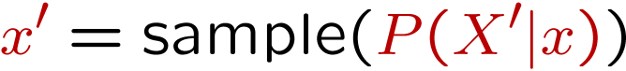
Particle Filtering: Elapse Time
Each particle is moved by sampling its next position from the transition model
This is like prior sampling – samples’ frequencies reflect the transition probabilities
Here, most samples move clockwise, but some move in another direction or stay in place
This captures the passage of time
If enough samples, close to exact values before and after (consistent)
Particles:
(3,3)
(2,3)
(3,3)
(3,2)
(3,3)
(3,2)
(1,2)
(3,3)
(3,3)
(2,3)
Particles:
(3,2)
(2,3)
(3,2)
(3,1)
(3,3)
(3,2)
(1,3)
(2,3)
(3,2)
(2,2)

Slide 25
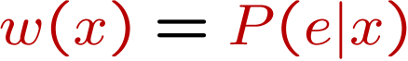
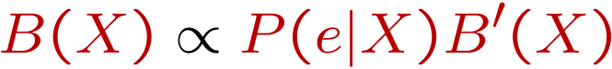
Particle Filtering: Observe
Particles:
(3,2)
(2,3)
(3,2)
(3,1)
(3,3)
(3,2)
(1,3)
(2,3)
(3,2)
(2,2)
Slightly trickier:
Don’t sample observation, fix it
Similar to likelihood weighting, downweight samples based on the evidence
As before, the probabilities don’t sum to one, since all have been downweighted (in fact they now sum to (N times) an approximation of P(e))
Particles:
(3,2) w=.9
(2,3) w=.2
(3,2) w=.9
(3,1) w=.4
(3,3) w=.4
(3,2) w=.9
(1,3) w=.1
(2,3) w=.2
(3,2) w=.9
(2,2) w=.4

Slide 26
Particle Filtering: Resample
Rather than tracking weighted samples, we resample
N times, we choose from our weighted sample distribution (i.e. draw with replacement)
This is equivalent to renormalizing the distribution
Now the update is complete for this time step, continue with the next one
Particles:
(3,2) w=.9
(2,3) w=.2
(3,2) w=.9
(3,1) w=.4
(3,3) w=.4
(3,2) w=.9
(1,3) w=.1
(2,3) w=.2
(3,2) w=.9
(2,2) w=.4
(New) Particles:
(3,2)
(2,2)
(3,2)
(2,3)
(3,3)
(3,2)
(1,3)
(2,3)
(3,2)
(3,2)

Slide 27
Recap: Particle Filtering
Particles: track samples of states rather than an explicit distribution
Elapse
Weight
Resample
Particles:
(3,3)
(2,3)
(3,3)
(3,2)
(3,3)
(3,2)
(1,2)
(3,3)
(3,3)
(2,3)
Particles:
(3,2)
(2,3)
(3,2)
(3,1)
(3,3)
(3,2)
(1,3)
(2,3)
(3,2)
(2,2)
Particles:
(3,2) w=.9
(2,3) w=.2
(3,2) w=.9
(3,1) w=.4
(3,3) w=.4
(3,2) w=.9
(1,3) w=.1
(2,3) w=.2
(3,2) w=.9
(2,2) w=.4
(New) Particles:
(3,2)
(2,2)
(3,2)
(2,3)
(3,3)
(3,2)
(1,3)
(2,3)
(3,2)
(3,2)
[Demos: ghostbusters particle filtering (L15D3,4,5)]

Slide 28
Video of Demo – Moderate Number of Particles

Slide 29
Video of Demo – One Particle

Slide 30
Video of Demo – Huge Number of Particles

Slide 31
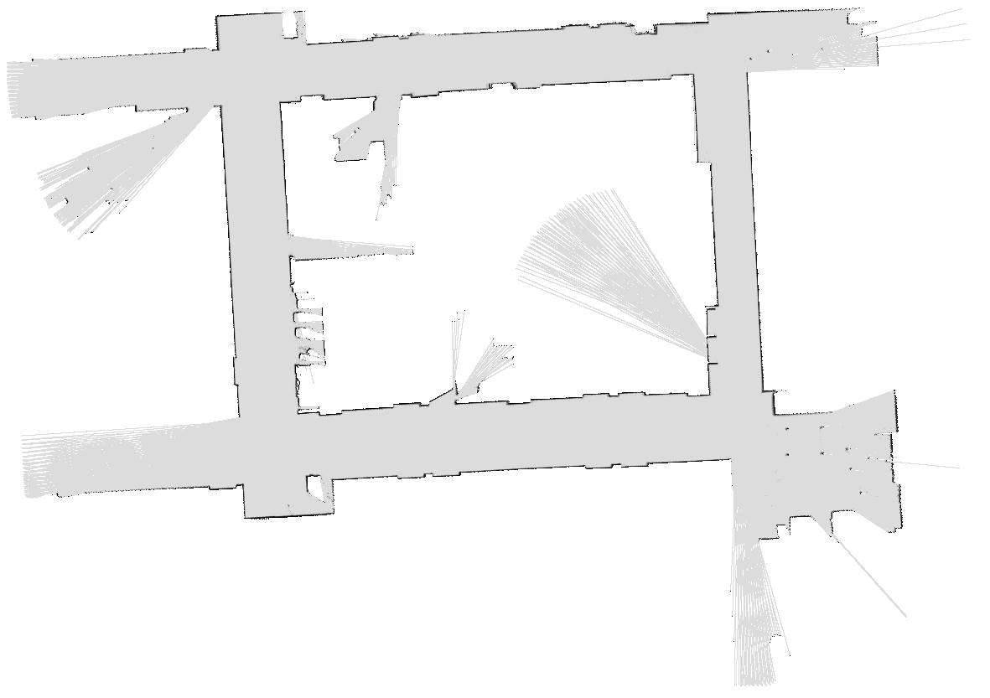
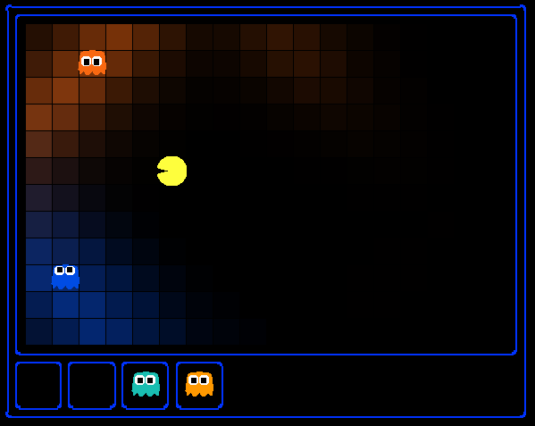
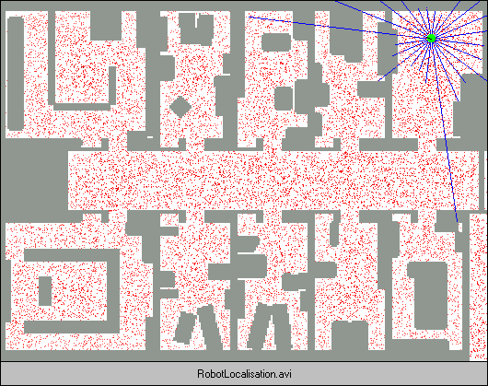
Demo Bonanza!

Slide 32
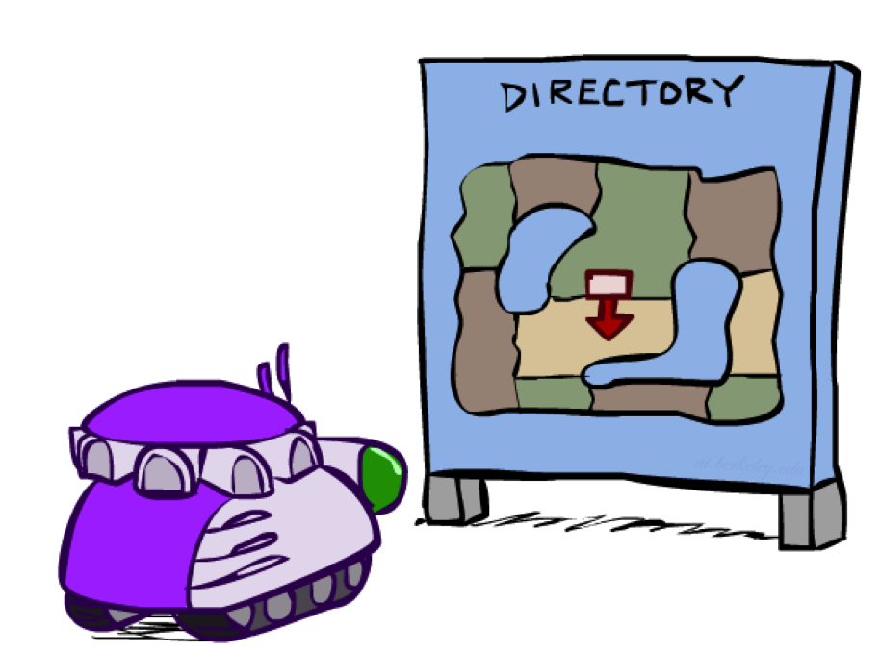
Robot Localization
In robot localization:
We know the map, but not the robot’s position
Observations may be vectors of range finder readings
State space and readings are typically continuous (works basically like a very fine grid) and so we cannot store B(X)
Particle filtering is a main technique

Slide 33
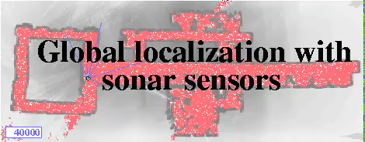
Particle Filter Localization (Sonar)
[Dieter Fox, et al.]
[Video: global-sonar-uw-annotated.avi]

Slide 34
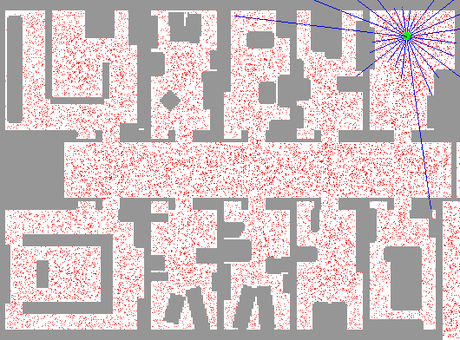
Particle Filter Localization (Laser)
[Dieter Fox, et al.]
[Video: global-floor.gif]

Slide 35

Robot Mapping
SLAM: Simultaneous Localization And Mapping
We do not know the map or our location
State consists of position AND map!
Main techniques: Kalman filtering (Gaussian HMMs) and particle methods
DP-SLAM, Ron Parr
[Demo: PARTICLES-SLAM-mapping1-new.avi]

Slide 36

Particle Filter SLAM – Video 1
[Sebastian Thrun, et al.]
[Demo: PARTICLES-SLAM-mapping1-new.avi]

Slide 37

Particle Filter SLAM – Video 2
[Dirk Haehnel, et al.]
[Demo: PARTICLES-SLAM-fastslam.avi]

Slide 38
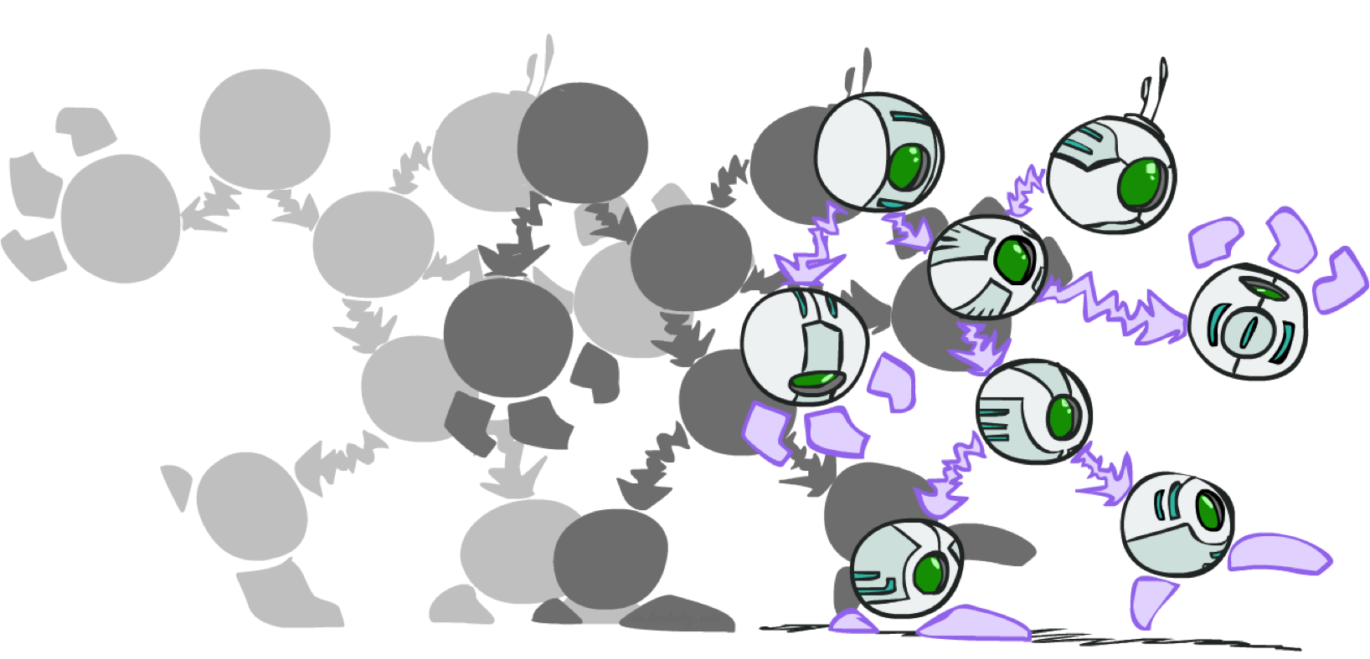
Dynamic Bayes Nets

Slide 39
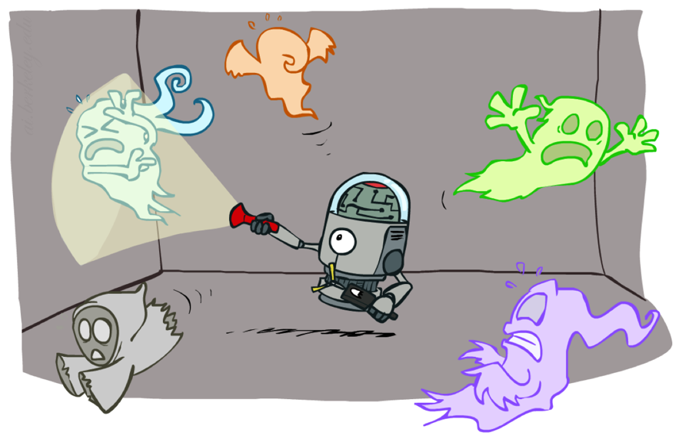
Dynamic Bayes Nets (DBNs)
We want to track multiple variables over time, using multiple sources of evidence
Idea: Repeat a fixed Bayes net structure at each time
Variables from time t can condition on those from t-1
Dynamic Bayes nets are a generalization of HMMs
t =1
t =2
t =3
G₁ª
G₂ª
G₃ª
G₁^{b}
G₂^{b}
G₃^{b}
E₁ª
E₁^{b}
E₂ª
E₂^{b}
E₃ª
E₃^{b}
[Demo: pacman sonar ghost DBN model (L15D6)]

Slide 40
Video of Demo Pacman Sonar Ghost DBN Model

Slide 41
Exact Inference in DBNs
Variable elimination applies to dynamic Bayes nets
Procedure: “unroll” the network for T time steps, then eliminate variables until P(X_{T}|e_{1:T}) is computed
Online belief updates: Eliminate all variables from the previous time step; store factors for current time only
t =1
t =2
t =3
G₁ª
G₂ª
G₃ª
G₃^{b}
G₁^{b}
G₂^{b}
G₃^{b}
E₁ª
E₁^{b}
E₂ª
E₂^{b}
E₃ª
E₃^{b}

Slide 42
DBN Particle Filters
A particle is a complete sample for a time step
Initialize: Generate prior samples for the t=1 Bayes net
Example particle: G₁ª = (3,3) G₁^{b} = (5,3)
Elapse time: Sample a successor for each particle
Example successor: G₂ª = (2,3) G₂^{b} = (6,3)
Observe: Weight each entire sample by the likelihood of the evidence conditioned on the sample
Likelihood: P(E₁ª |G₁ª ) * P(E₁^{b} |G₁^{b} )
Resample: Select prior samples (tuples of values) in proportion to their likelihood
Notes:
Dan has a demo here.

Slide 43
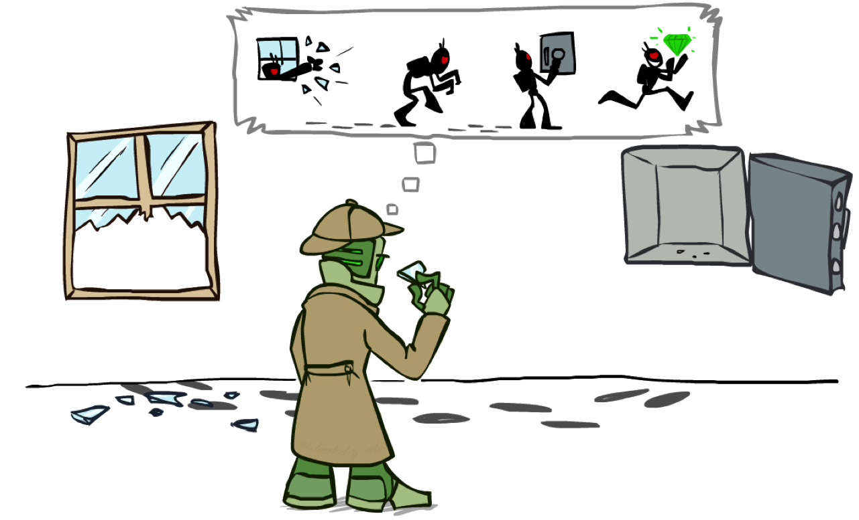
Most Likely Explanation

Slide 44

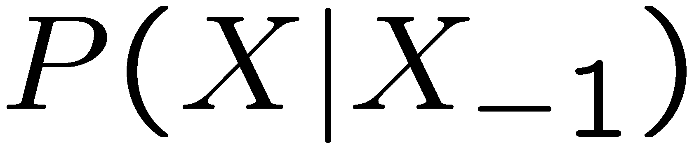

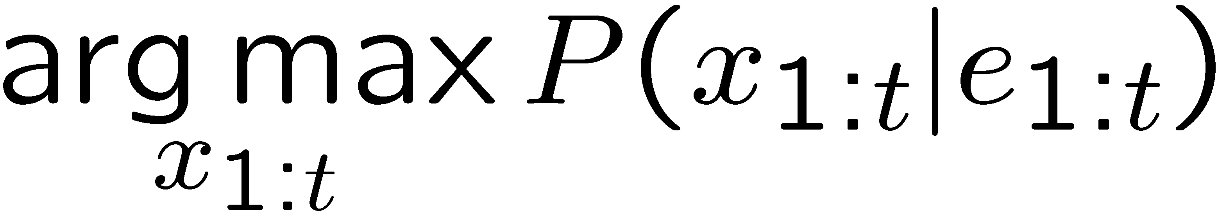
HMMs: MLE Queries
HMMs defined by
States X
Observations E
Initial distribution:
Transitions:
Emissions:
New query: most likely explanation:
New method: the Viterbi algorithm
X₁
X₂
X₃
X₄
X₅
E₁
E₂
E₃
E₄
E₅

Slide 45

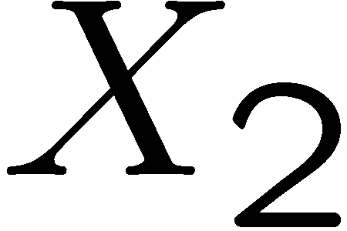

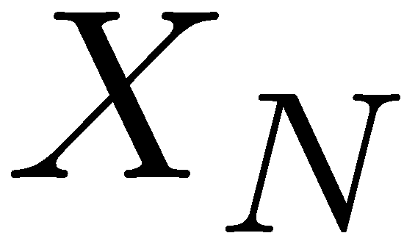

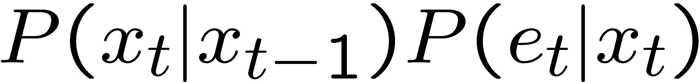
State Trellis
State trellis: graph of states and transitions over time
Each arc represents some transition
Each arc has weight
Each path is a sequence of states
The product of weights on a path is that sequence’s probability along with the evidence
Forward algorithm computes sums of paths, Viterbi computes best paths
sun
sun
sun
sun
rain
rain
rain
rain

Slide 46
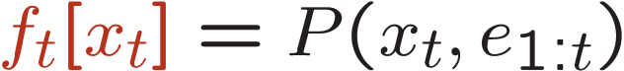
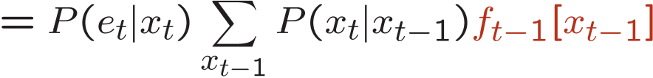
Forward / Viterbi Algorithms
sun
sun
sun
sun
rain
rain
rain
rain
Forward Algorithm (Sum)
Viterbi Algorithm (Max)

